Slide 1
Business Goals
Despite the world becoming increasingly digital, there is still demand for notebooks, pens and sticky notes. Our focus has been on selling products to enable our customers to be more creative, focused on tools for brainstorming. We have tested three different sales strategies for this, targeted email and phone calls, as well as combining the two.
Launching a new product line is expensive and we need to make sure we are using the best techniques to sell the new product effectively.

Slide 2
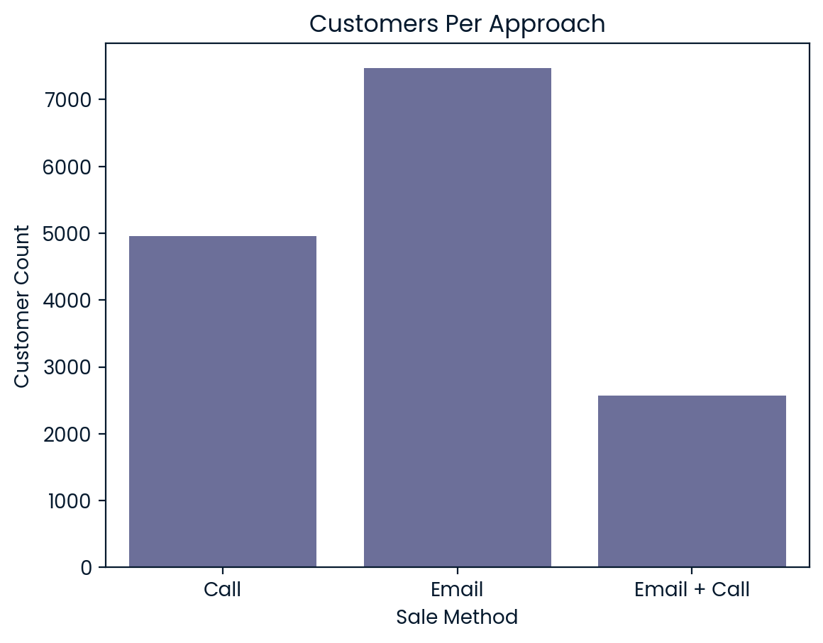
Outcomes
How many customers were there for each approach?
From the 6 weeks since launch, we can see that there were over 7000 customers contacted by email, just under 5000 customers contacted by call and just over 2500 customers contacted by email + call. We should focus on improving the number of Emails + calls as there is huge room for improvement.

Slide 3
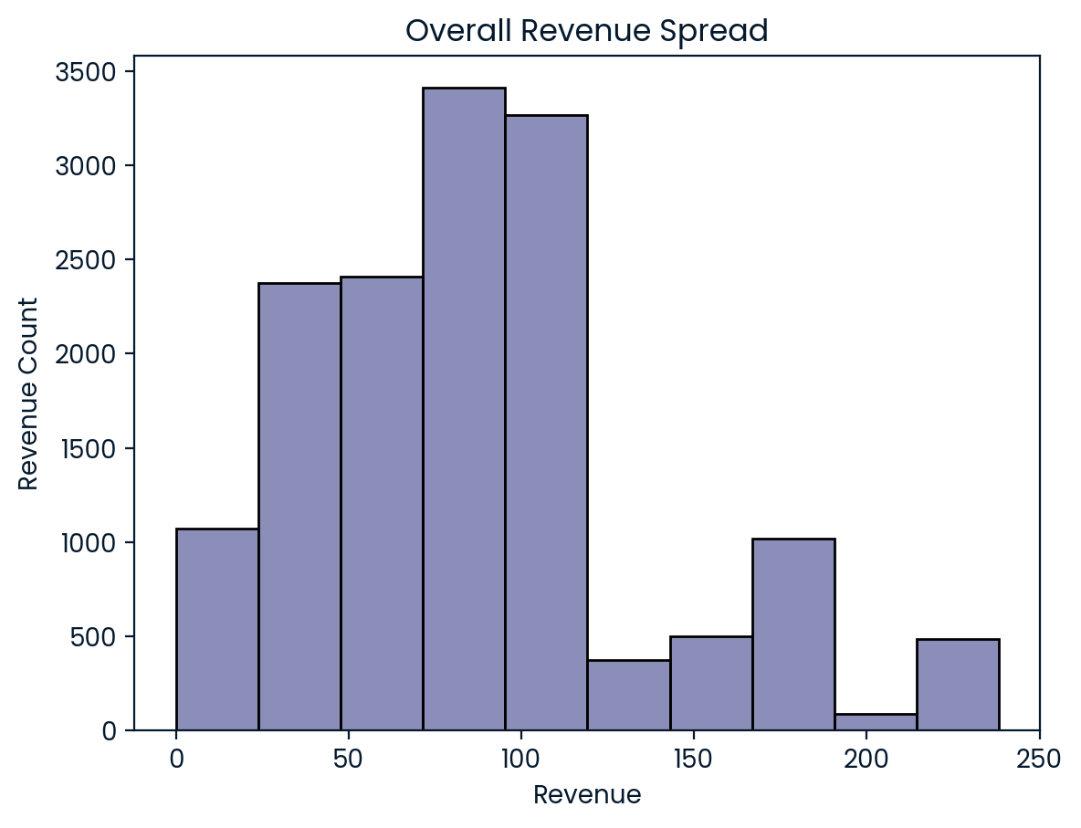
Outcomes
What does the spread of the revenue look like overall?
I looked at distribution of revenue across all sales methods. the majority revenue made across all methods is less than £180, we can see the highest amount of revenue is between £25 and £120. This is due to the spread of revenue per sales method.

Slide 4
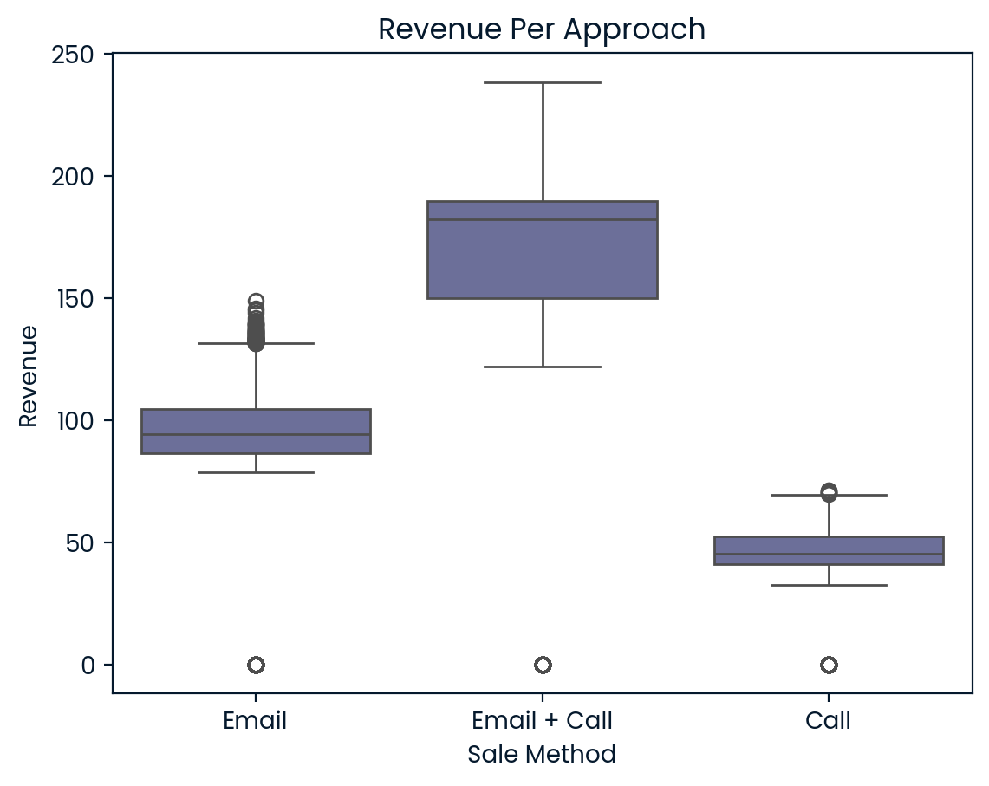
Outcomes
What does the spread of the revenue look like per approach?
From the multiple boxplots we can clearly see the revenue from Email + Call is significantly higher than just a call and higher than just an email. Most of the Email + Call generated between £145 and £180 revenue, generating up to £240 much higher than the overall average.
Emails, also generated revenue over £100 with a few outliers over £130.
Calls don't do nearly as well as most of the revenue is under £50 which is under the overall average.

Slide 5
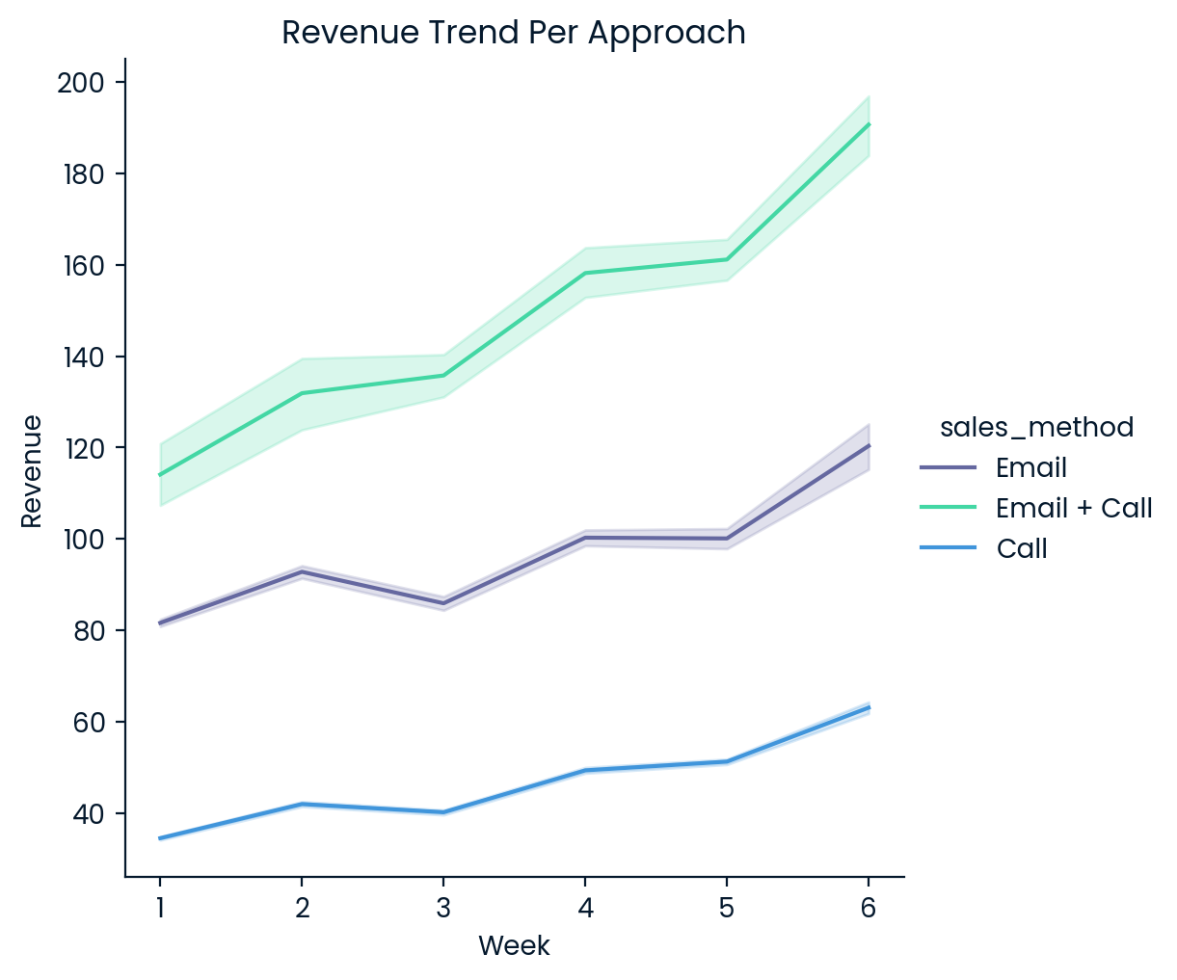
Outcomes
Was there any difference in revenue over time for each of the methods?
As we can see from the line graph there a lot of difference in revenue over time for each method. Email + Call saw the biggest rise in revenue from under £120 to over £180, but both Email and Call also saw a slight increase over the weeks. The trend seems to show a slight dip or stagnation after a week of increased revenue with none of the sale methods showing a big increase 2 weeks in a row.

Slide 6
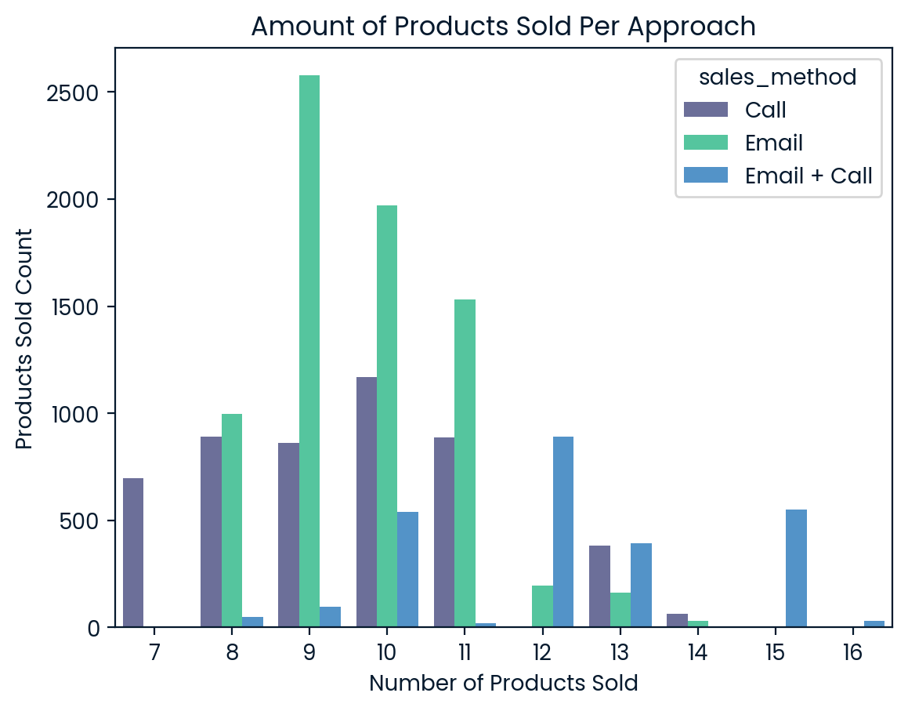
Outcomes
How many products were sold per approach?
From this graph we can see Emails generate the most amount of product sales, this could be due to the number of emails that can be sent out very quickly. Calls coming in second closely followed by Email + Calls. based on this information if we wanted to sell the greatest number of products quickly, Emails would be the best choice.

Slide 7
Business Metrics
Since the goal is to find the best approach and sees what works and doesn't work, I would recommend using Email + Call if revenue is what's most important, as it clearly brings in the most revenue. But, due to significantly more Emails that can be sent out we should continue with these as they also generate a lot of revenue through more products being sold.
There is an upwards trend for all methods but due to the significant increase in revenue for Email + Call I think we should focus on these.

Slide 8
Recommendations
For the foreseeable future I recommend we focus on these steps:
- We should stop Calls as they are very time consuming and do not generate as much revenue as the other methods
- We should continue to use Email + Call and Email as these have proven to generate a good amount of revenue.
- We should increase the amount of Email + Call as these generate the most revenue and do not take as much time as calls, this can lead to a significant increase in revenue for the company.

